Slide 1

Figure 1.
(a)
(b)
Figure 1. (a) Distributions of the 53370 crystal structures of subset 1 (all Ln complexes) and the 29891 crystal structures of subset 2 (mononuclear Ln complexes) over the Ln series. (b) Distributions of 8991 crystal structures of mononuclear Ln complexes with water in first shell (subset 2w) and 4209 crystal structures of mononuclear Ln complexes with nitrate in first shell (subset 2n).
Notes:
How many nitrate and water in first shell at leat one nitrate with phen
Remove subset2 in b

Slide 2
Figure 1.
(a)
(b)
Figure 1. (a) Distributions of the 53370 crystal structures of subset 1 (all Ln complexes) and the 29891 crystal structures of subset 2 (mononuclear Ln complexes) over the Ln series. (b) Distributions of 8991 crystal structures of mononuclear Ln complexes with water in first shell (subset 2w) and 4209 crystal structures of mononuclear Ln complexes with nitrate in first shell (subset 2n).
Notes:
How many nitrate and water in first shell at leat one nitrate with phen
Remove subset2 in b

Slide 3
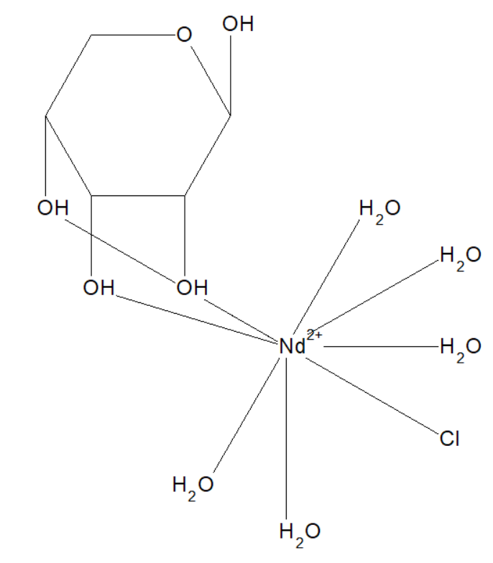
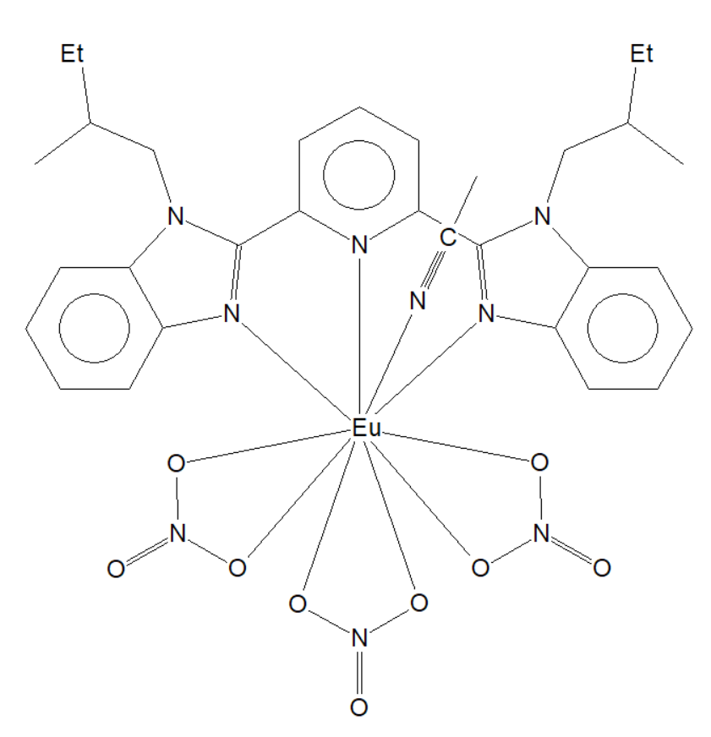
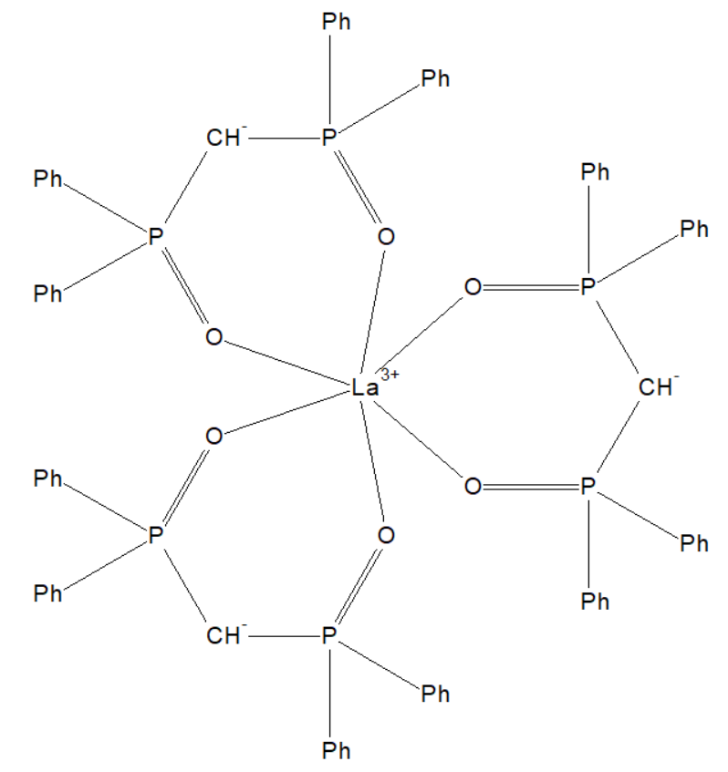
(c)
(d)
(e)
AMEWEU
EKUHEA
AREBII

Slide 4
Figure 2.
Figure 2. Distribution of 11349 crystal structures of mononuclear Ln complexes with either nitrate only or water only or both in first shell (subset 3).

Slide 5
Figure 3.
(a)
(b)
Figure 3. (a) Distribution of the number of water molecules in the first coordination shell across the Ln series for structures in subset 2w; (b) distribution of the number of nitrate in the first coordination shell across the Ln series for structures in subset 2n.

Slide 6
(a)
(b)

Slide 7
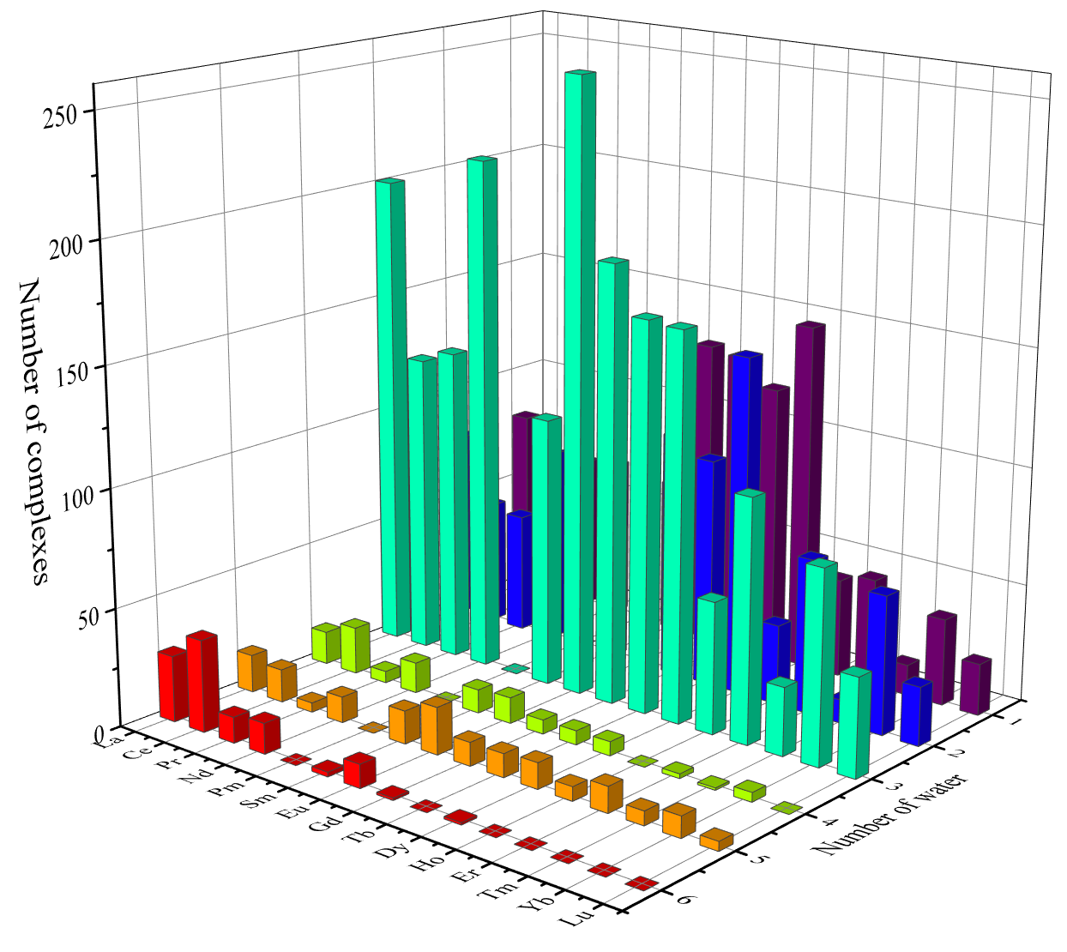
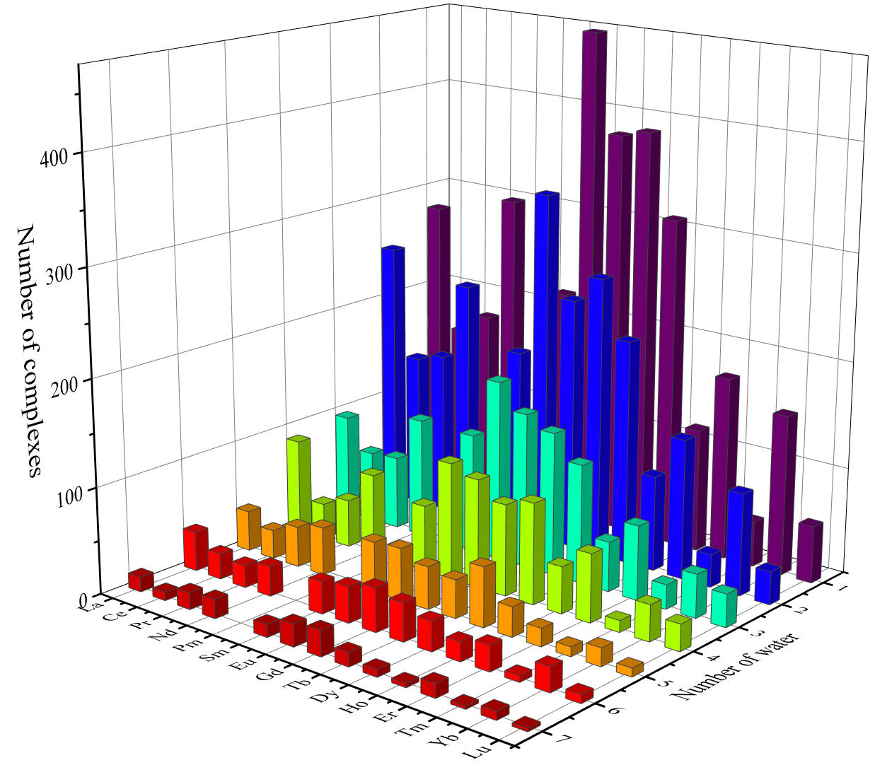

Slide 9
(a)
(b)

Slide 10
Figure 4.
Figure 4. Distribution of different coordination modes of nitrate in the first coordination shell across the Ln series for structures in subset 2n.

Slide 11
Figure 5.
Figure 5. Average coordination number of the first coordination shell of Ln complexes in subset 2, subset 2n, and subset 2w across the Ln series. Standard deviations are shown as the error bars.

Slide 12
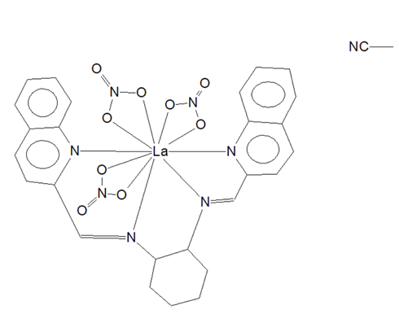
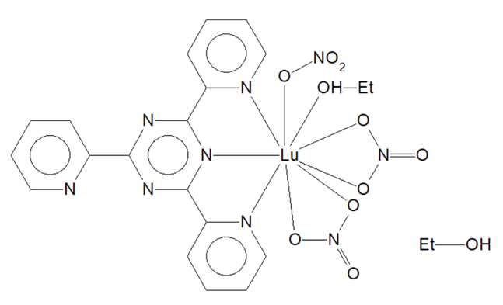
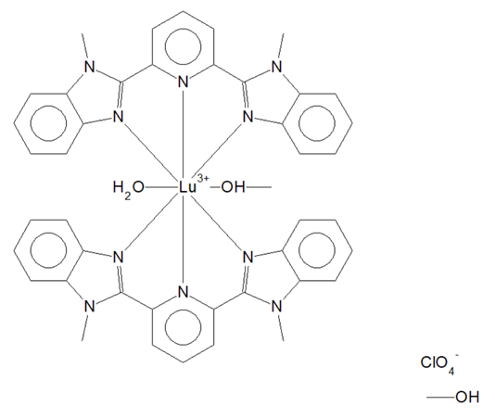
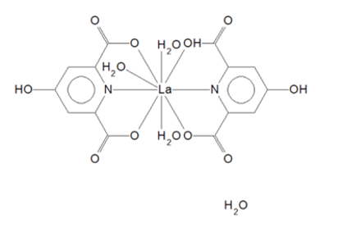
Figure 6.
(a)
(b)
(c)
(d)
Figure 6. Example structures in subset 2n and subset 2w that have the average coordination numbers (CNs): (a) La complex (CSD code: BENBII), CN = 10 in subset 2n; (b) Lu complex (CSD code: ACUKUF), CN = 9 in subset 2n; (c) La complex (CSD code: FADBOD), CN = 9 in subset 2w; (d) Lu complex (CSD code: HANMUE), CN = 8 in subset 2w.

Slide 13
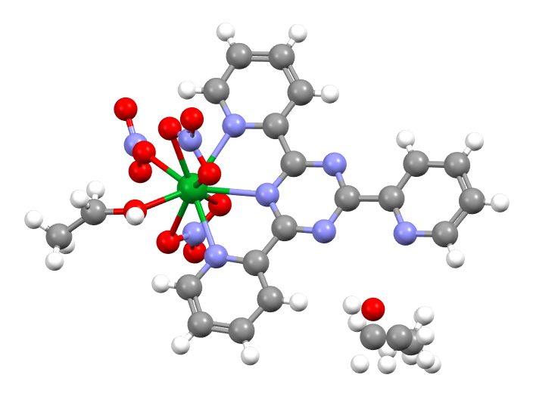
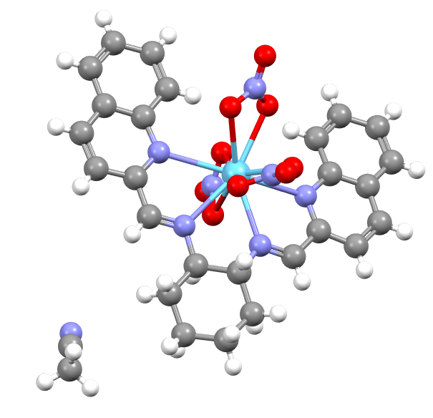
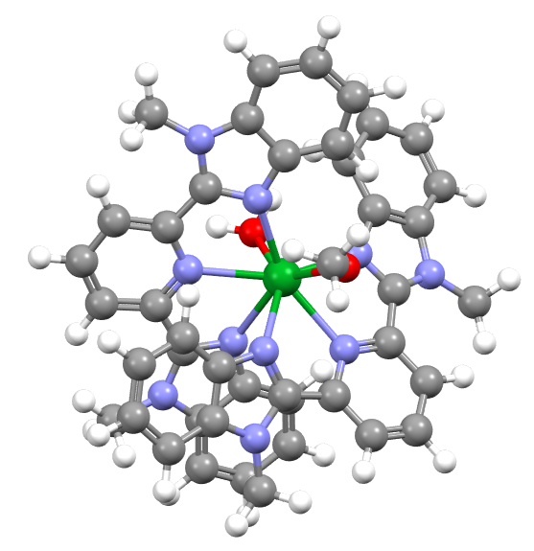
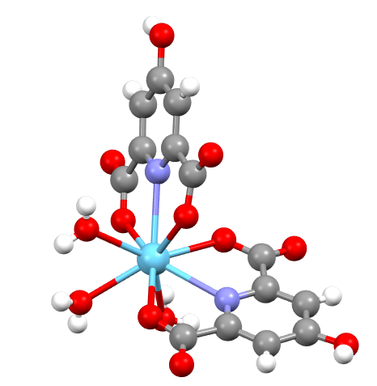
(a)
(b)
(c)
(d)

Slide 14
Figure 7.
(a)
(b)
Figure 7. Distribution of the net charge of the first coordination shell across the Ln series for structures in (a) subset 2w and (b) subset 2n.
Notes:
Add one more fig for subset2nw

Slide 15
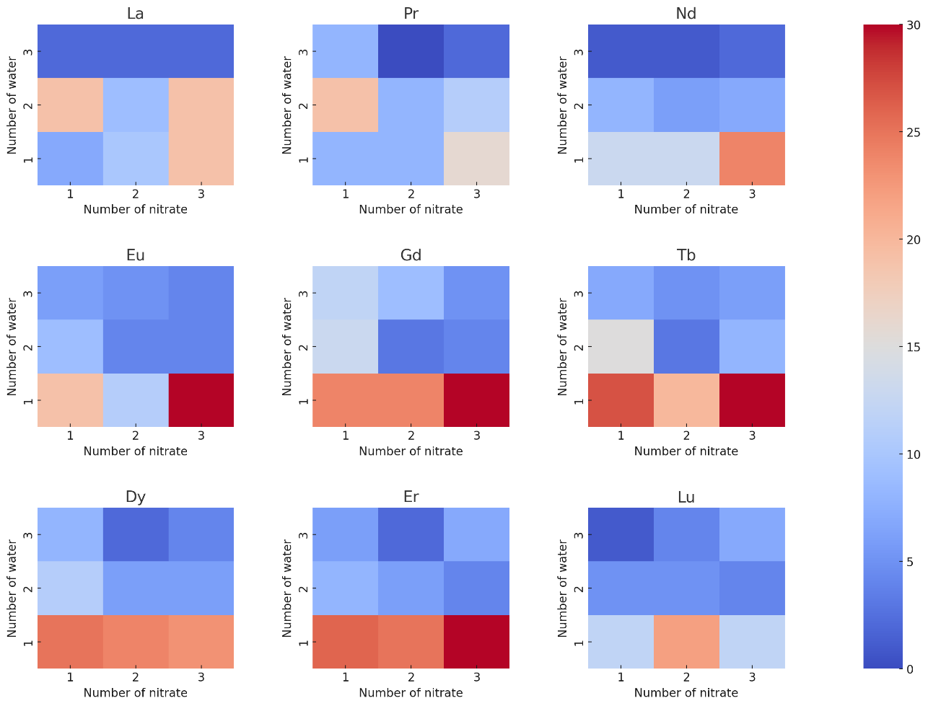
Figure 9.
Figure 9. Distribution of water and nitrate numbers in the first coordination shells of Ln complexes in subset 4. Each subplot represents a specific lanthanide ion (La, Pr, Nd, Eu, Gd, Tb, Dy, Er, Lu) and the color scale indicates the frequency of configurations (number of structures).
Notes:
Add one more fig for subset2nw

Slide 16
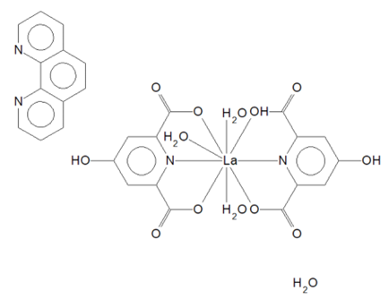

Slide 17
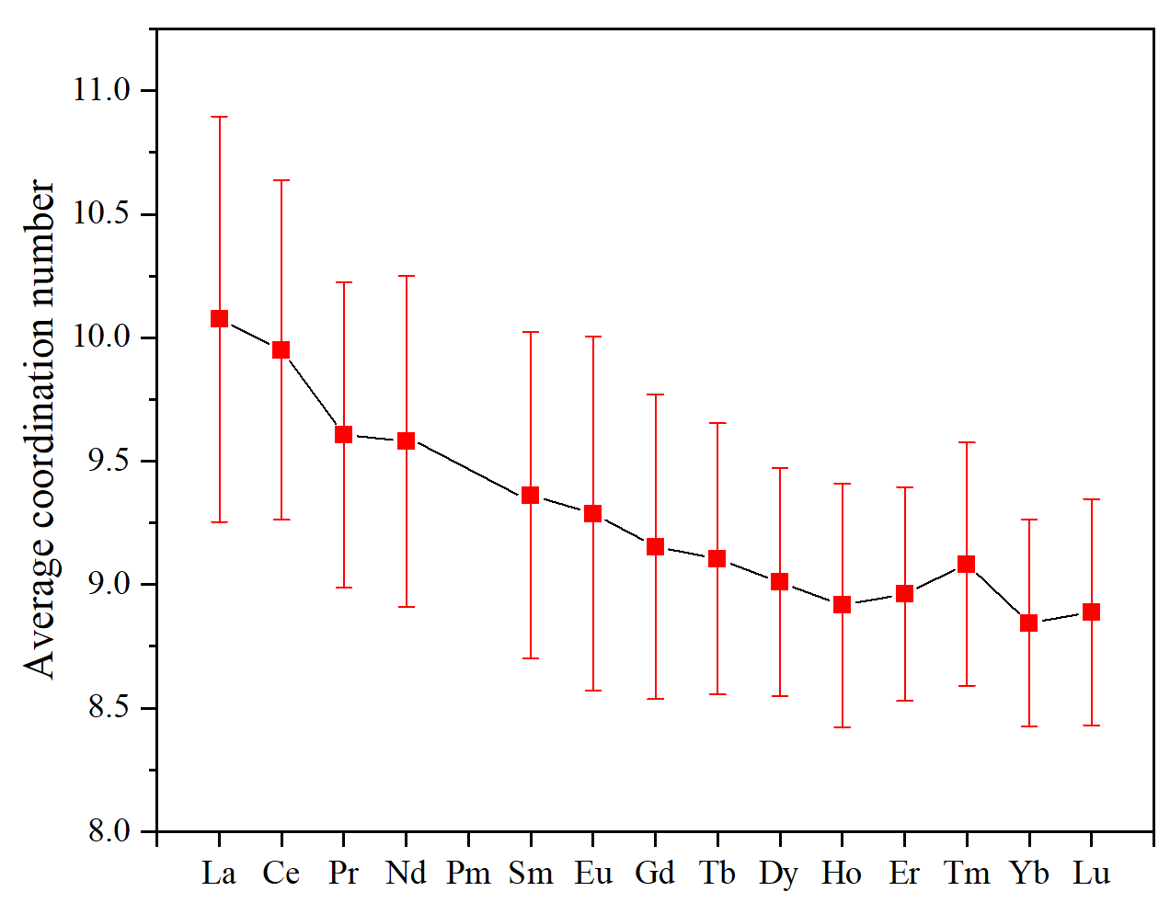

Figure 7.
(a)
(b)
Figure 7. Average ratio of nitrate/water in first coordination shell of 935 mononuclear Ln complexes containing both water and nitrate in the first shell (subset 4). Standard deviations are shown as the error bars.

Slide 18
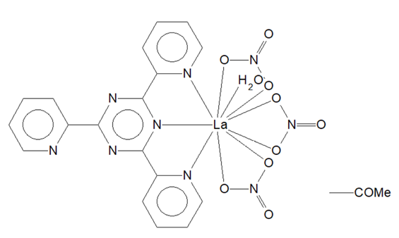
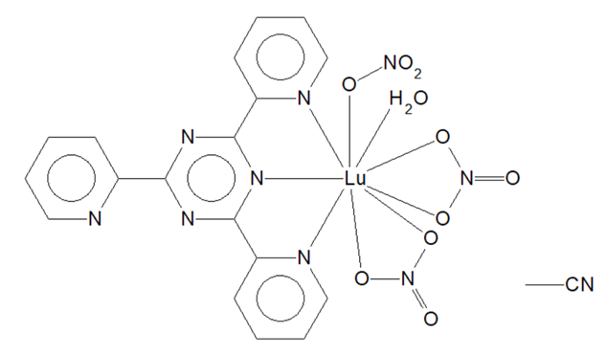
Figure 7.
(a)
(b)
(c)
Figure 7. Average ratio of nitrate/water in first coordination shell of 935 mononuclear Ln complexes containing both water and nitrate in the first shell (subset 4). Standard deviations are shown as the error bars.

Slide 19
Figure 7.
(a)
(b)
(c)
Figure 7. Average ratio of nitrate/water in first coordination shell of 935 mononuclear Ln complexes containing both water and nitrate in the first shell (subset 4). Standard deviations are shown as the error bars.

Slide 20
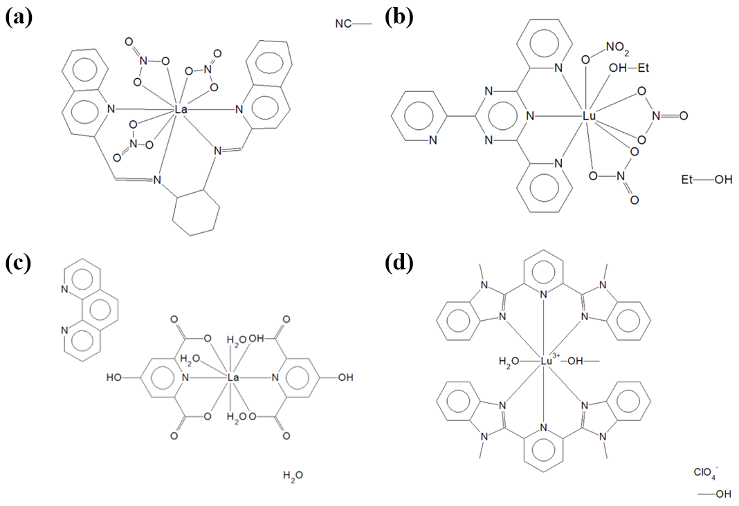

Slide 21
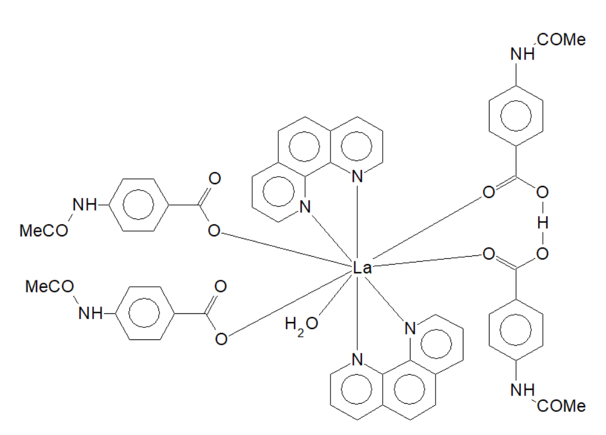


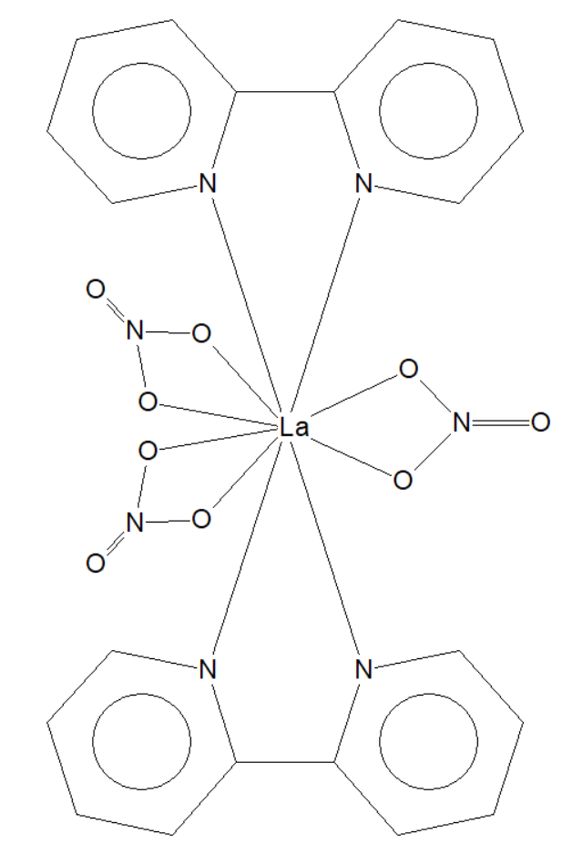

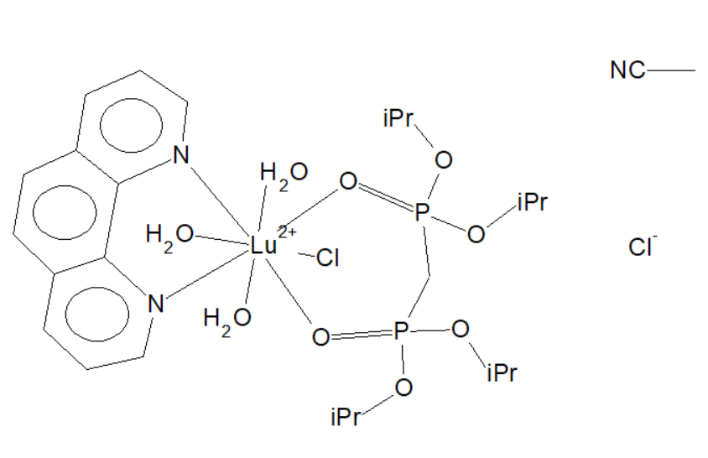

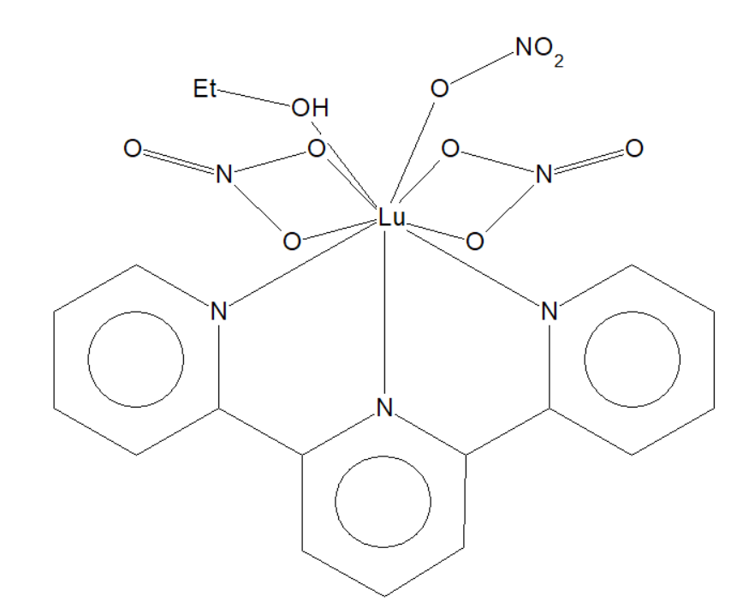
Template
HUKXER
FADBOD
BENBII
NIBPLA01
XUJWAC
HANMUE
ACUKUF
EFIZOI

Slide 22

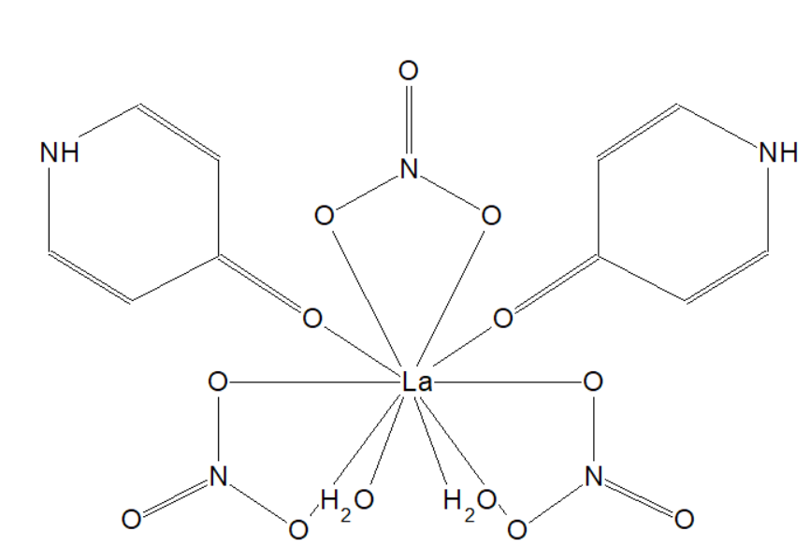
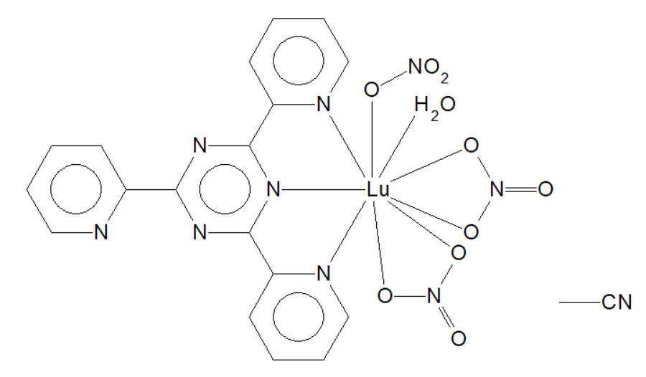
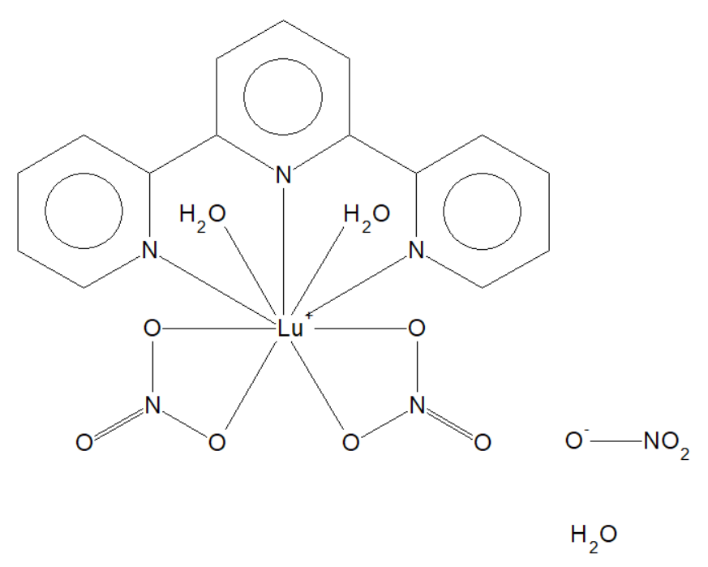
Template
ACUGOV
DAYMOG
ACULAM
XAWVAS

Slide 23
Figure 1. (old)
subset2
subset2n
subset2w
subset2n_org
subset2w_org
subset2n_no_w_org
subset2n_w_org
subset2w_no_n_org
Figure 1. Distribution of 29891 crystal structures of subset2 (mononuclear Ln complexes), 8991 crystal structures of subset2w (Ln complexes with water in first shell) and 4209 crystal structures of subset2n (Ln complexes with nitrate in first shell) .

Slide 24
Figure SI
Figure S1. Distribution of 4209 crystal structures of subset2n (Ln complexes with nitrate in first shell) and 3840 crystal structures of subset2n_org (Ln complexes with nitrate and organic ligand(s) in first shell) .
Figure S2. Distribution of 8991 crystal structures of subset2w (Ln complexes with water in first shell) and 8,444 crystal structures of subset2w_org (Ln complexes with water and organic ligand(s) in first shell) .

Slide 25
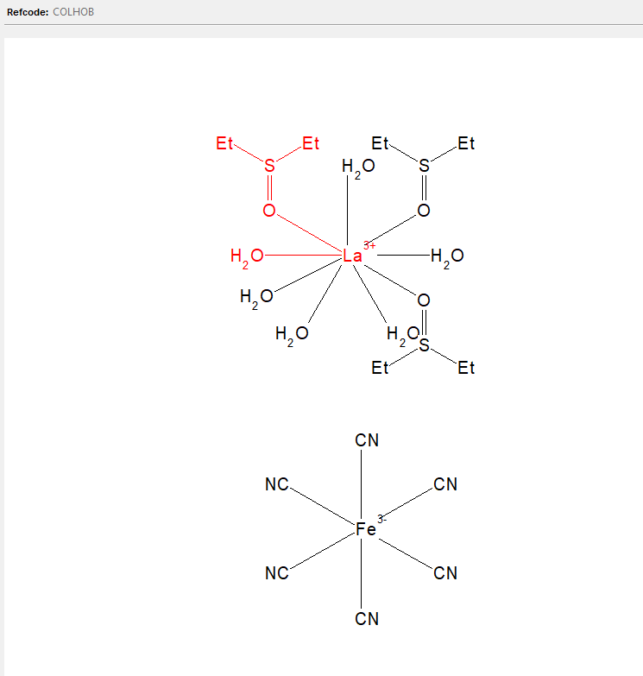
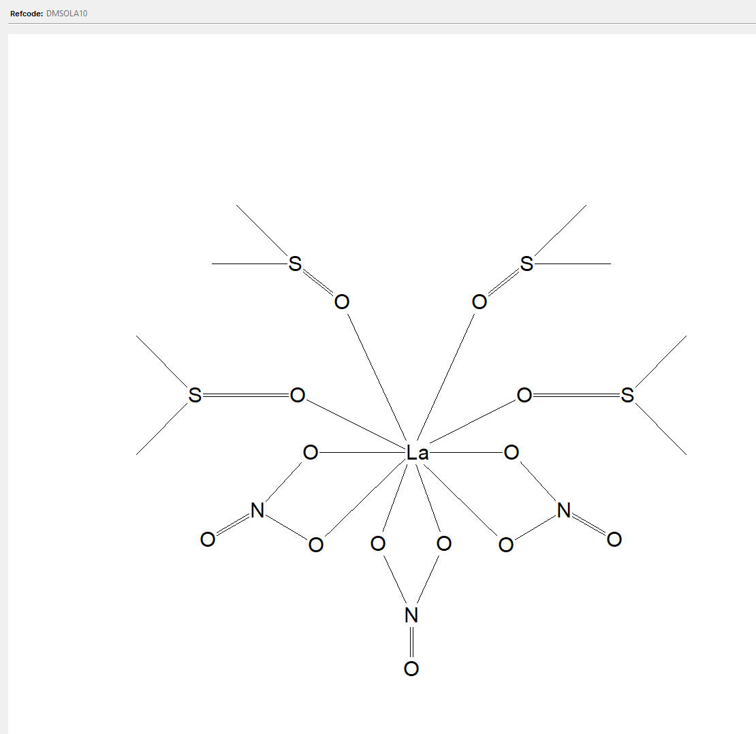
Monodentate ligand
(DMSO)
CN=9
CN=10

Slide 26
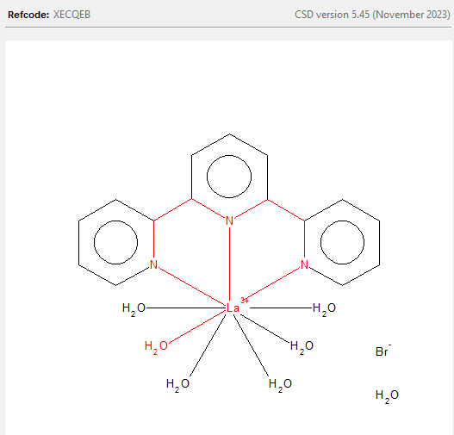
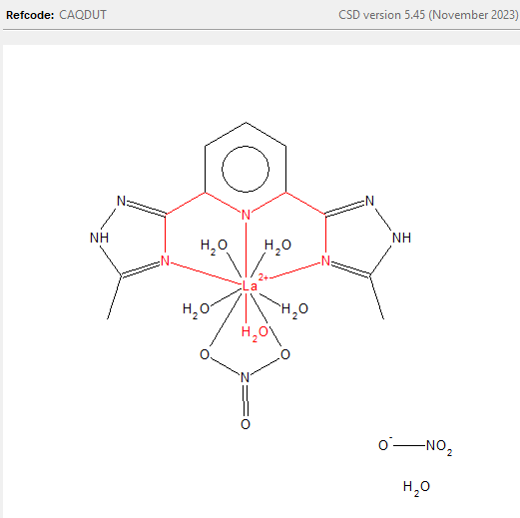
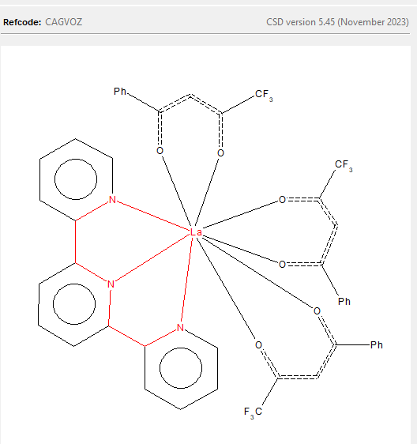
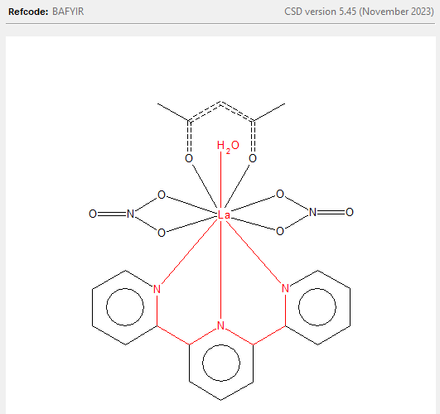
Tridentate ligand
(Terpyridine)
CN=9
CN=10
1,3-diketones are similar to nitrates
But bond angle differs
Notes:
Bond angle distance phen with 4

Slide 27
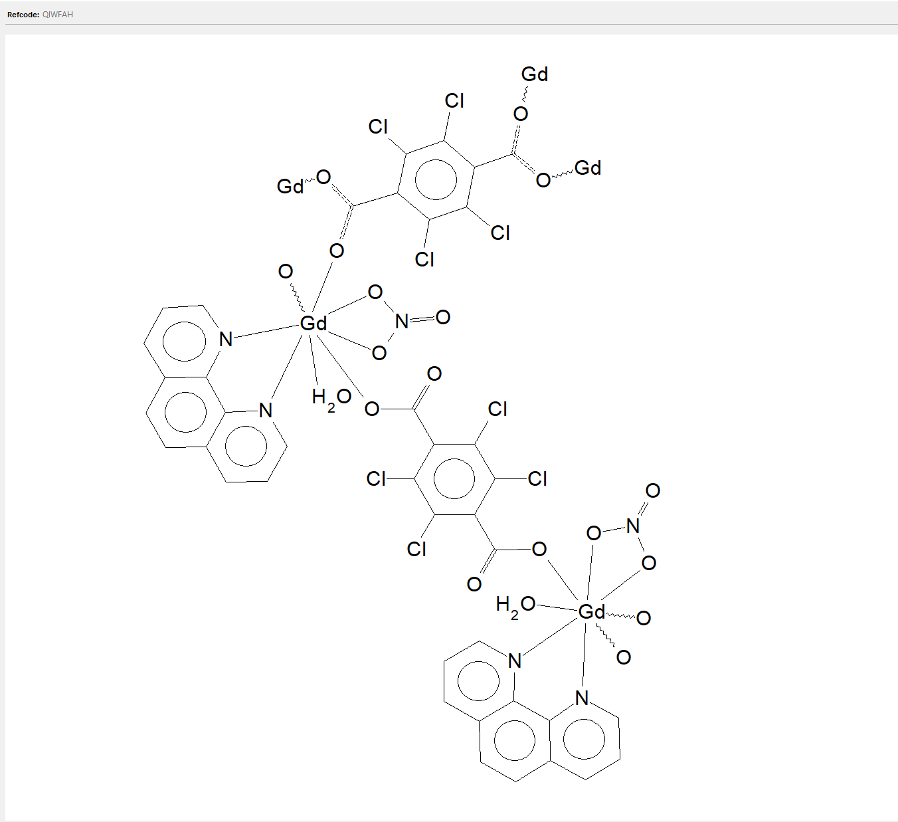
Figure 6.
(a)
(b)
Figure 6. Distribution of neutral first shell and non neutral first shell in (a)subset2n and (b)subset2w.

Slide 28
Figure 7.
(a)
(b)
(c)
(d)
Figure 7. Average net charge in first shell of Ln complexes in (a)subset2n (b)subset2w (c)subset2n_non_neutral (d)subset2w_non_neutral across the Ln series; Standard deviations are shown as the error bars.

Slide 29
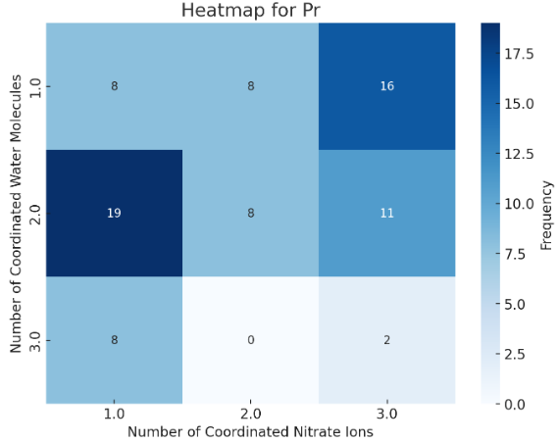
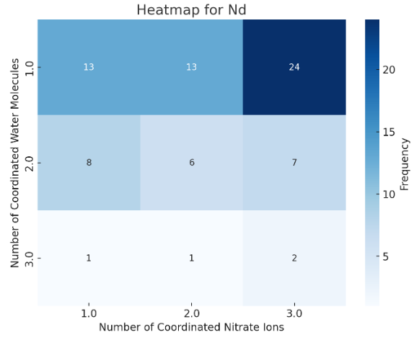
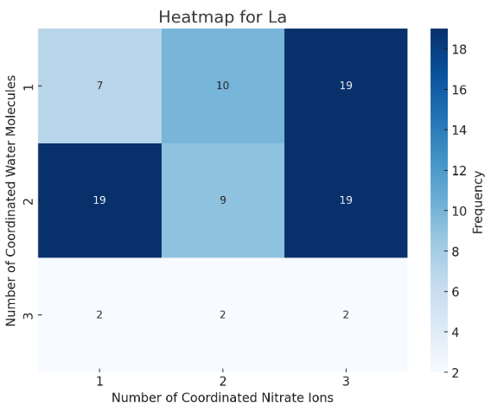
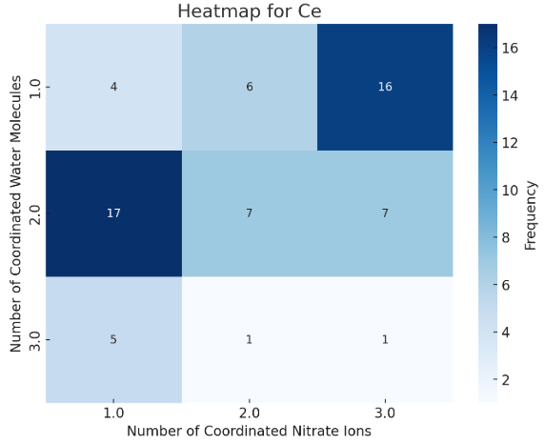
Template

Slide 30
Template

Slide 31
Template

